Slide 1


Operationalization of Food, Nutrition, Health and WASH (FNHW) interventions through
Self Help Groups and its Federations
Orientation of CLF/VO- SAC/EC/OB
National Mission Management Unit, Deendayal Antyodaya Yojana – National Rural Livelihoods Mission (DAY-NRLM)
Ministry of Rural Development, Government of India

Slide 2
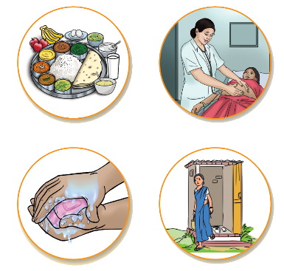




Why integrate FNHW?
Proper Nutrition

Health Services

Increased savings
Overall wellbeing and improved quality of life
Appropriate Sanitation and Hygiene
Less Expenditure on Health/Diseases

Slide 3
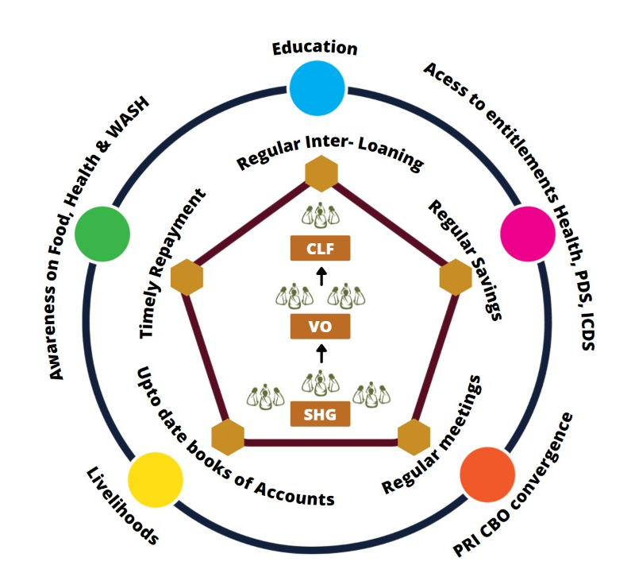
Dashasutra Strategy- 2016
Integrating livelihoods and social development for holistic growth of communities
Micro-credit and financing
Including social development - Food, Nutrition, Health and WASH, Gender etc.

Slide 4



FNHW Focus Areas
FOOD
Nutri-Garden
Access to PDS
Access to THR
Mid Day Meal
FNHW Enterprises
HEALTH & NUTRITION
Antenatal Care | Anaemia reduction
New Born Care | Family Planning
1000 Days | Health & Nutrition for the Elderly and PWD
Infant and Young Child Feeding | Nutrition and Health during NCDs
Maternal Nutrition | Menstrual Hygiene
Family Diet diversity
WASH
Use of sanitary toilet
Handwashing practices
Management of household waste

Slide 5
Strategic Pillars
System Strengthening
  To improve ability of the system to integrate FNHW
Convergence
  Facilitate convergence between Health, WCD and PRI etc. for improved service delivery
SBCC
  Promote behavior change among SHGs
FNHW Enterprises
  Promote establishment of FNHW enterprises managed by SHGs

Slide 6
Overview of State FNHW Operational Strategy
Next few slides (9-13) are specific to State FNHW Operational Strategy. State Managers are expected to fill in the desired information.

Slide 7
FNHW Synthesis from State Operational Strategy
3. Goal
4. Objectives
5. Clientele/Target Group

Slide 8
Key interventions to be implemented as per State FNHW Operational Strategy

Slide 9
Implementation Structure for Operationalization of FNHW
SHG Level HR
VO Level HR
CLF Level HR
State Mission Management Unit
District Mission Management Unit
State Programme Manager SI & SD
Program Manager, State Resource Person/Master Trainers
District Programme Manager IB-CB, District resource pool
Block Mission Management Unit
Social Action Committee (consisting 5 members)
Office Bearers/ Executive Committee
Block Programme Manager, resource pool
Social Action Committee (consisting of 3 members)
Community Resource Person (CRP)
FNHW Nodal(Community Mobilizer/Active Woman etc.)
Note: The above implementation structure is suggestive. States may modify this as per their State FNHW Operational Strategy.

Slide 10

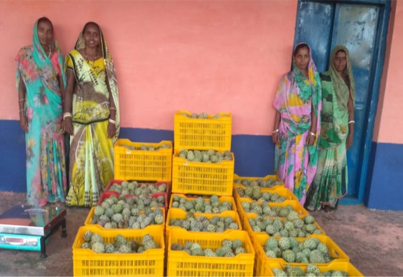
Roles and responsibilities at CLF level
CLF SAC members
CLF OB/EC members
Develop FNHW Action Plan
Coordinate with BMMU for FNHW related information/ guidance
Review performance of VO SAC committee
Collate all VO reports and compile to submit to block
Undertake frequent monitoring visits to assess VO for FNHW activities
Grade VOs based on their FNHW performance
Release payment of CRP/FNHW cadre based on performance review
Hold regular meetings with functionaries of line departments (ANM, Anganwadi Supervisor, PRI member etc.)
Support in establishment of reward mechanism for CLF/VO/SHG
Upward and downward coordination for establishment of FNHW enterprises
Facilitate release, monitor utilization and augmentation of Vulnerability Reduction Fund
  Participate in POSHAN Abhiyaan/POSHAN Pakhwada and other events

Slide 11
Roles and responsibilities at VO level
Develop Annual FNHW Action Plan
Review FNHW progress at VO level
Support FNHW CRP to implement FNHW interventions in rolling out of FNHW interventions:
Rollout FNHW sessions during monthly meetings
Organize VO level Community events/campaigns
Undertake home-visit/peer counselling
Participate in VHSND planning, provide support in making VHSND more community friendly and mobilize SHGs
Monitor progress of SHGs on FNHW activities
Represent SHG members at community forums/committees (VHSNC/Gram Sabhas)
Coordinate convergence with village level frontline functionaries (ASHA and AWW) and representatives of line departments (PRI etc.)
Mobilize target groups to participate in VO level events
Undertake Vulnerability Reduction Planning including VRF augmentation for SHG members
Collate SHG level reports of interventions and report to the CLF Level
Support to establish reward mechanism
  Participate in POSHAN Abhiyaan/POSHAN Pakhwada and other events

Slide 12
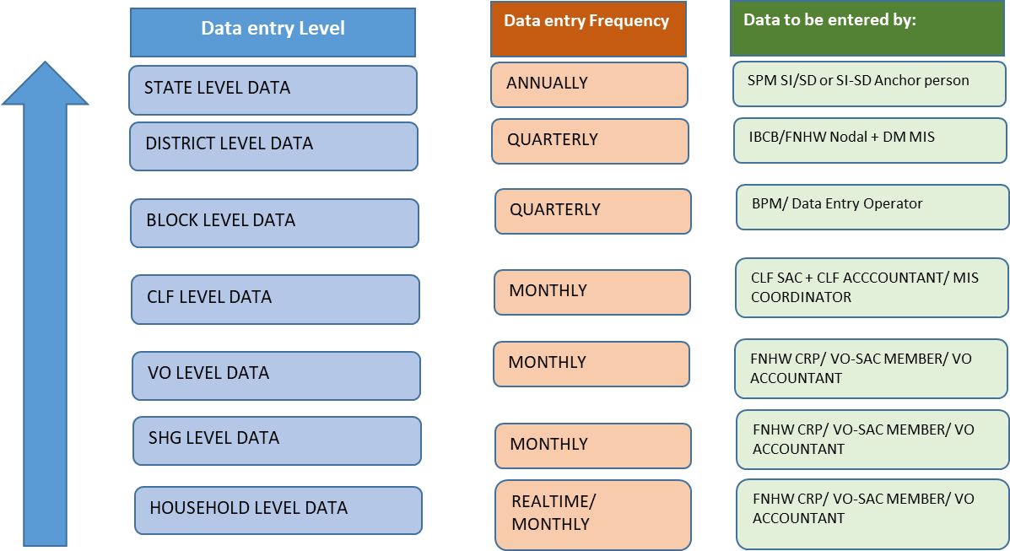
Reporting structure for FNHW
Reporting Mechanism

Slide 13
Suggested indicators
Suggested Indicators
# | Indicators
Progress of FNHW Interventions | Progress of FNHW Interventions
1 | # of target beneficiaries in SHG HHs in the reporting month (pregnant women/lactating women/adolescents/elderly etc.) | No. of CLFs initiated FNHW activities
2 | % SHGs conducted monthly meeting on FNHW | No. of SHGs conducted monthly meeting on FNHW
3 | % SHGs oriented on FNHW modules | No. of SHGs oriented on FNHW modules
4 | % SHG women oriented on FNHW modules | No. of SHG member households having functional toilet
5 | % VOs organized community events on FNHW (campaigns/rallys/competitions etc.) | No. of VOs having trained cadre on FNHW
6 | % VOs participated in VHSNC/JAS/RKS meeting | No. of VO-SAC participated in VHSND
7 | # of VO running an FNHW enterprise | No. of VOs conducted community events on FNHW
Include any other indicator as proposed in the State FNHW Operational Strategy
Ensure quality of data reported in MIS

Slide 14
Facilitator may add more components (such as FNHW Action planning, review and convergence etc.) depending upon the requirement. Please refer Presentation for Facilitator’s Orientation on Functions of CLF/VO SAC/OB/EC for the same.

Slide 15
Introduction to National FNHW Resource Package

Slide 16
Themes under National FNHW Resource package
1. Linkages with livelihoods and FNHW
2. Malnutrition cycle and first 1000 days
3. Antenatal care
4. Maternal nutrition
5. Care of the newborn
6. Infant and Young Child Feeding (IYCF)
7. Balanced and diverse diet for the family
8. Nutri-gardens
9. Public Distribution System/Take Home Ration
10. Anaemia
11. Hygiene related behaviours
12. Family planning
13. Adolescent nutrition and health
14. Menstrual hygiene and related behaviours
15. Management of waste at home
16. Nutrition and health for the elderly
17. Non Communicable Diseases (NCDs) 18. Women’s health issues

Slide 17
List of resource materials
Standard Operating Procedure Booklet- to provide detailed guidance on operational and programmatic components
Facilitator Guide for Trainer- to facilitate trainers in rolling out sessions on FNHW
Flipbooks for Trainers to use during SHG meetings
IEC Materials for home visits, community events, etc.
  Posters – for display during community events and awareness generation
  Banners – for events like campaigns and rallies
  Stickers – to serve as reminders on key messages
  Counselling Cards – to be used during home visits and smaller interactions
Presentations for orientation of state/district/block managers and CLF/VO level SAC members
Use of package is subjected to prioritizing themes, contextualizing, translation, phase wise use and implementing as per State FNHW Operational Strategy.

Slide 18


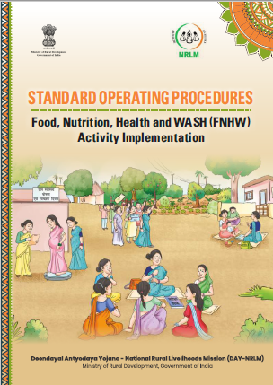
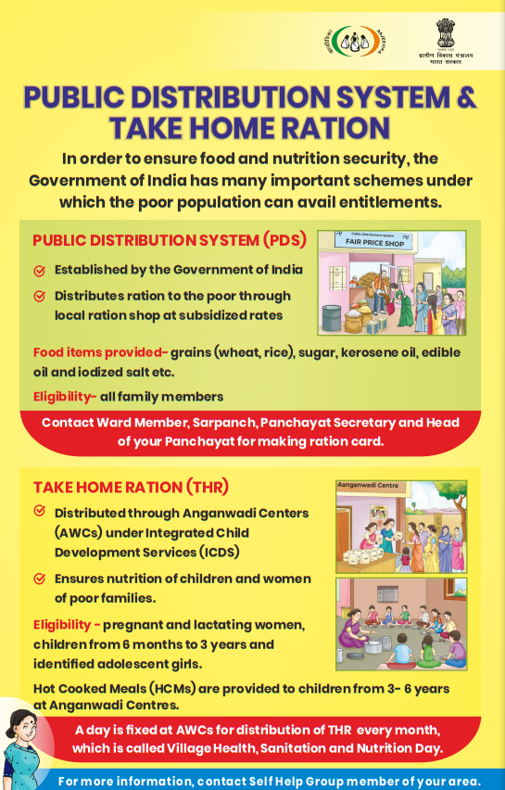
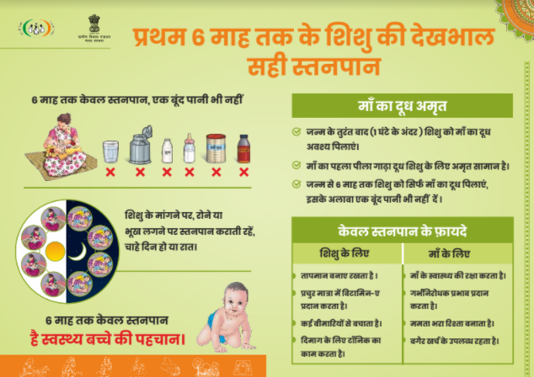

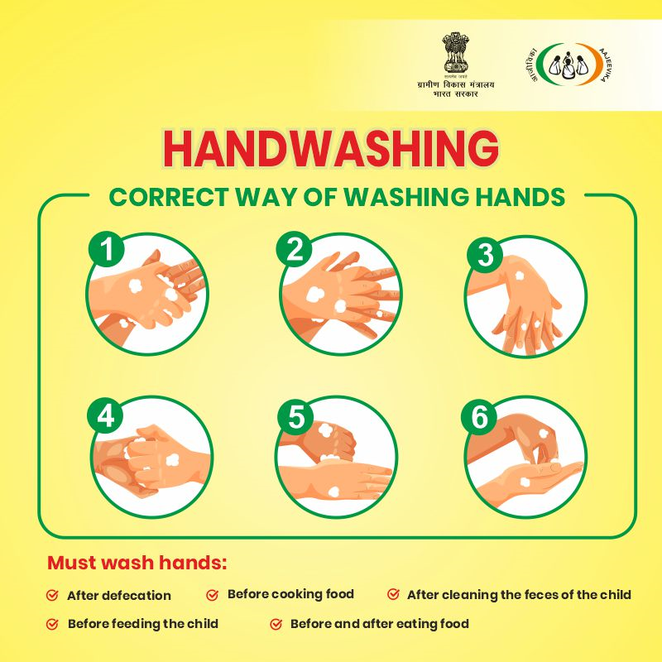
Glimpse of resource materials FNHW

Slide 19
Thankyou

